Slide 1
Apache Kafka

Slide 2
What Is Apache Kafka?
Apache Kafka is a distributed commit log service
– Widely used for data ingest
– Conceptually similar to a publish-subscribe messaging system
– Offers scalability, performance, reliability, and flexibility

Slide 3


Batch vs Streaming

Slide 4
Characteristics of Kafka
§ Scalable
– Kafka is a distributed system that supports multiple nodes
§ Fault-tolerant
– Data is persisted to disk and can be replicated throughout the cluster
§ High throughput
– Each broker can process hundreds of thousands of messages per second
§ Low latency
– Data is delivered in a fraction of a second
§ Flexible
– Decouples the production of data from its consumption

Slide 5
Kafka Use Cases
§ Kafka is used for a variety of use cases, such as
– Log aggregation
–Messaging
–Web site activity tracking
– Stream processing
– Event sourcing

Slide 6
Key Terminology
Message
– A single data record passed by Kafka
§ Topic
– A named log or feed of messages within Kafka
§ Producer
– A program that writes messages to Kafka
§ Consumer
– A program that reads messages from Kafka

Slide 7
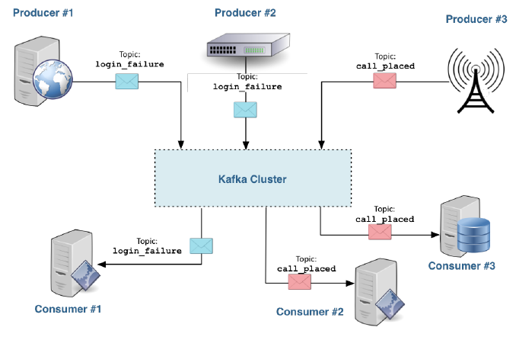
Example: High-Level Architecture

Slide 8
Message
§ Messages in Kafka are variable-size byte arrays
– Represent arbitrary user-defined content
– Use any format your application requires
– Common formats include free-form text, JSON
§ There is no explicit limit on message size
– Optimal performance at a few KB per message
– Practical limit of 1MB per message
Kafka will retain messages regardless of whether they were read
– Kafka discards messages automatically after the retention period

Slide 9
Message
§ Kafka retains all messages for a defined time period and/or total size
– Administrators can specify retention on global or per-topic basis
– Kafka will retain messages regardless of whether they were read
– Kafka discards messages automatically after the retention period or
total size is exceeded (whichever limit is reached first)
– Default retention is one week
– Retention can reasonably be one year or longer

Slide 10
Topics
§ There is no explicit limit on the number of topics
–However, Kafka works better with a few large topics than many small ones
§ A topic can be created explicitly or simply by publishing to the topic
– This behavior is configurable

Slide 11
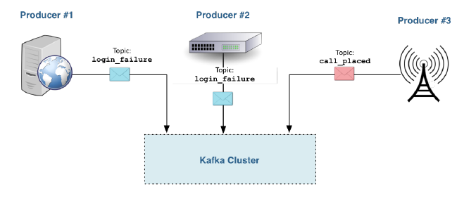
Producers
§ Producers publish messages to Kafka topics
– They communicate with Kafka, not a consumer
– Kafka persists messages to disk on receipt

Slide 12
Consumers
§ A consumer reads messages that were published to Kafka topics
– They communicate with Kafka, not any producer
§ Consumer actions do not affect other consumers
– For example, having one consumer display the messages in a topic as
they are published does not change what is consumed by other
consumers

Slide 13
Producers and Consumers
§ Tools available as part of Kafka
– Command-line producer and consumer tools
– Client (producer and consumer) Java APIs
§ A growing number of other APIs are available from third parties
– Client libraries in many languages including Python, PHP, C/C++, Go,
.NET, and Ruby
§ Integrations with other tools and projects include
– Apache Flume
– Apache Spark
–Amazon AWS
– syslog
§ Kafka also has a large and growing ecosystem

Slide 14
Scaling Kafka
§ Scalability is one of the key benefits of Kafka
§ Two features let you scale Kafka for performance
– Topic partitions
– Consumer groups

Slide 15
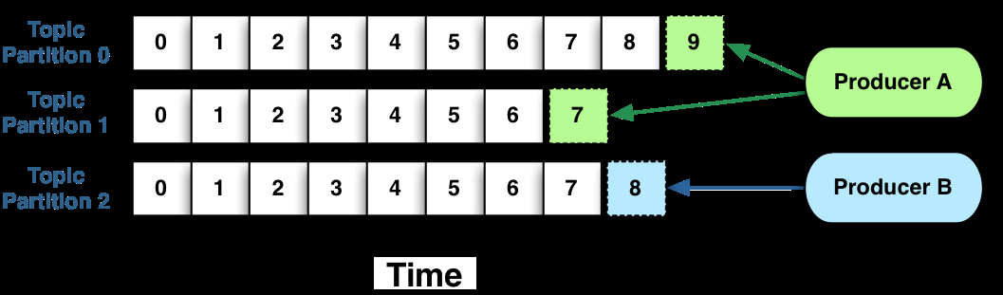
Topic Partitioning
§ Kafka divides each topic into some number of partitions *
– Topic partitioning improves scalability and throughput
§ A topic partition is an ordered and immutable sequence of messages
– New messages are appended to the partition as they are received
– Each message is assigned a unique sequential ID known as an offset

Slide 16
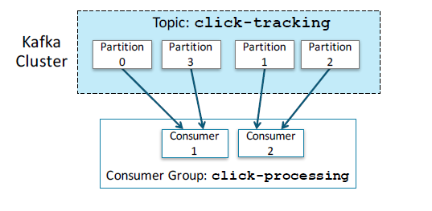
Consumer Groups
One or more consumers can form their own consumer group that work
together to consume the messages in a topic
§ Each partition is consumed by only one member of a consumer group

Slide 17
Increasing Consumer Throughput
§ Additional consumers can be added to scale consumer group processing
§ Consumer instances that belong to the same consumer group can be in
separate processes or on separate machines

Slide 18
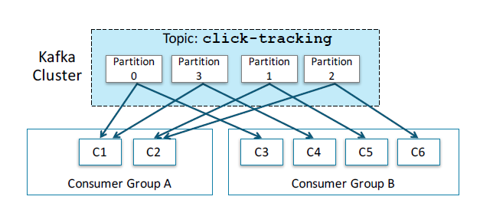
Multiple Mesaage groups
§ Each message published to a topic is delivered to one consumer instance within each subscribing consumer group

Slide 19
Publish and Subscribe to Topic
Kafka functions like a traditional queue when all consumer instances
belong to the same consumer group
– In this case, a given message is received by one consumer
§ Kafka functions like traditional publish-subscribe when each consumer
instance belongs to a different consumer group
– In this case, all messages are broadcast to all consumer groups

Slide 20
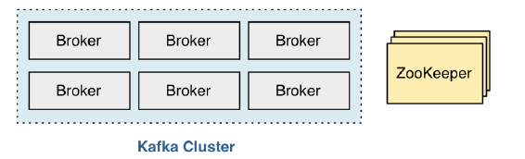
Kafka Clusters
§ A Kafka cluster consists of one or more brokers—servers running the Kafka broker daemon
§ Kafka depends on the Apache ZooKeeper service for coordination

Slide 21
Apache ZooKeeper
§ Apache ZooKeeper is a coordination service for distributed applications
§ Kafka depends on the ZooKeeper service for coordination
§ Kafka uses ZooKeeper to keep track of brokers running in the cluster
§ Kafka uses ZooKeeper to detect the addition or removal of consumers

Slide 22
Kafka Brokers
Brokers are the fundamental daemons that make up a Kafka cluster
§ A broker fully stores a topic partition on disk, with caching in memory
§ A single broker can reasonably host 1000 topic partitions
§ One broker is elected controller of the cluster

Slide 23
Topic Replication
§ At topic creation, a topic can be set with a replication count
–Doing so is recommended, as it provides fault tolerance
§ Each broker can act as a leader for some topic partitions and a follower for
others
– Followers passively replicate the leader
– If the leader fails, a follower will automatically become the new leader

Slide 24
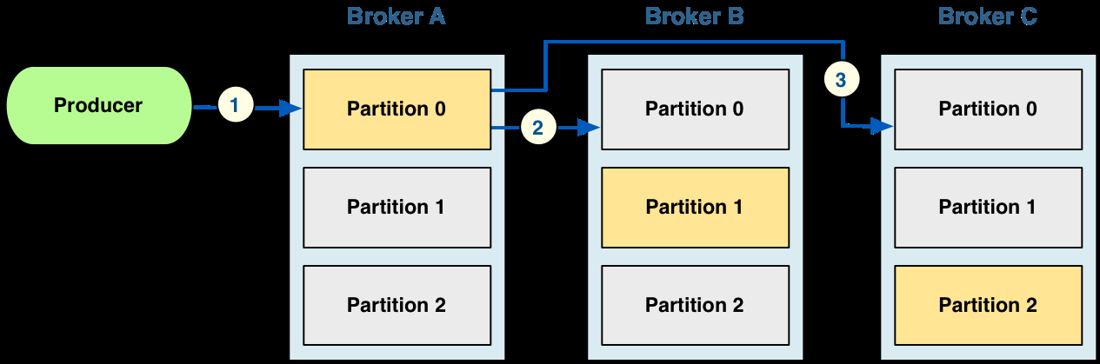
Messages Are Replicated
Configure the producer with a list of one or more brokers
– The producer asks the first available broker for the leader of the desired
topic partition
§ The producer then sends the message to the leader
– The leader writes the message to its local log
– Each follower then writes the message to its own log
– After acknowledgements from followers, the message is committed

Slide 25
Creating Topics from the Command Line
§ Kafka includes a convenient set of command line tools
– These are helpful for exploring and experimentation
§ The kafka-topics command offers a simple way to create Kafka topics
– Provide the topic name of your choice, such as device_status
kafka-topics --create \
--zookeeper zkhost1:2181,zkhost2:2181,zkhost3:2181 \
--replication-factor 3 \
--partitions 5 \
--topic device_status

Slide 26
Running a Producer from the Command Line
You can run a producer using the kafka-console-producer tool
§ Specify one or more brokers in the --broker-list option
– Each broker consists of a hostname, a colon, and a port number
– If specifying multiple brokers, separate them with commas
kafka-console-producer \
--broker-list brokerhost1:9092,brokerhost2:9092 \
--topic device_status

Slide 27
Running a Consumer from the Command Line
You can run a consumer with the kafka-console-consumer tool
§ This requires the ZooKeeper connection string for your cluster
–Unlike starting a producer, which instead requires a list of brokers
§ The command also requires a topic name
kafka-console-consumer \
--zookeeper zkhost1:2181,zkhost2:2181,zkhost3:2181 \
--topic device_status \
--from-beginning

